Slide 1
Finance Manager
Juan Higuera
04/22/2025
COMPSCI‑2

Slide 2
Motivation
My motivation for creating the Finance Manager project came from sometimes forgetting about a bill I had to pay by the end of the month as well as not remembering to cancel subscriptions before being charged again. I wrote down my bills and subscription on a sheet of paper since then, but I thought it would be much better and less of a hassle to just have it all inside one program which can be updated regularly and automated in the future. I think the Finance Manager program can be a very useful tool to make sure you stay on track with your expenses.

Slide 3
FinanceManager
addTransaction()/deleteTransaction()
addBudget()/deleteBudget()
displayAllTransactions()/displayAllBudgets()
loadData()/saveData()
Budget
getCategory()
getAllocatedAmount()
getSpent()
isResetMonthly()
Transaction
getType()
getAmount()
getCategory()
getDescription()
getDate()
Key Classes
FinanceManager:
Holds & orchestrates all Transaction and Budget objects
Adds/removes items, updates budget spending, handles CSV I/O via FileUtils
Transaction:
Records type (income/expense), amount, category, description, timestamp
Can serialize/deserialize to CSV
Budget:
Tracks a monthly “allocated” vs. “spent” amount per category
Supports reset, CSV serialization/deserialization
C++ Features Used
Smart pointers (std::unique_ptr) for clear ownership & no leaks
STL containers (std::vector) to hold dynamic collections
Streams & File I/O (std::ifstream/std::ofstream) for CSV persistence
Chrono library (std::chrono::system_clock) for timestamps
Unit testing via Catch2 (catch_amalgamated.hpp) for automated verification

Slide 4
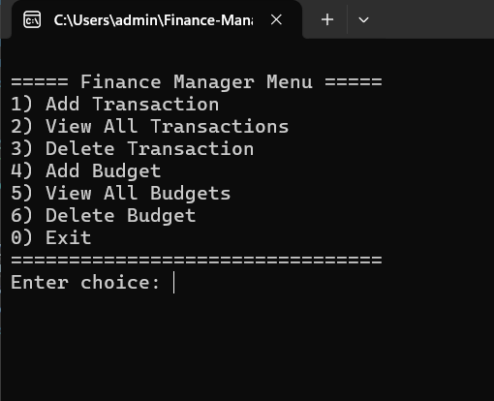
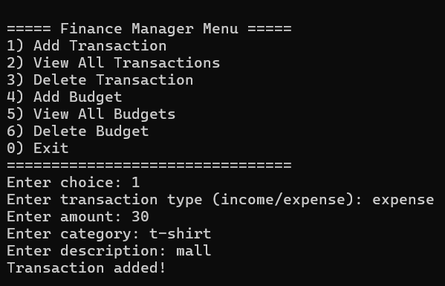
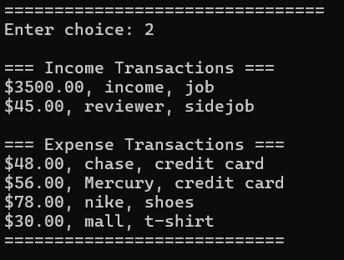
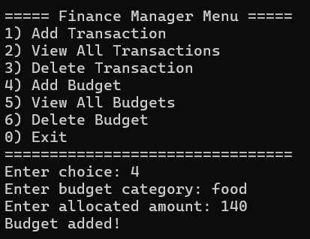
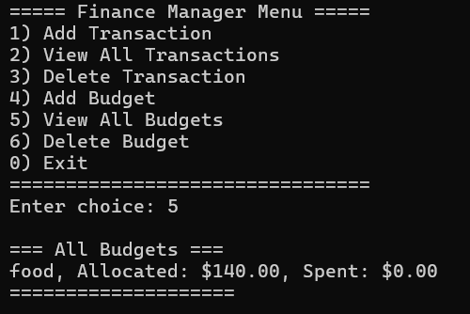
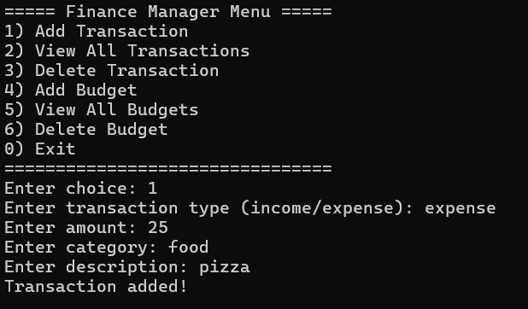
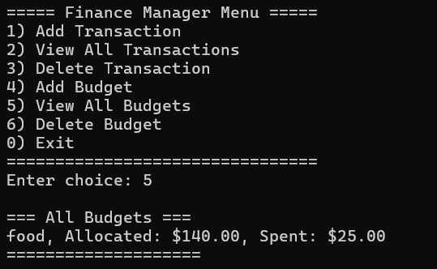
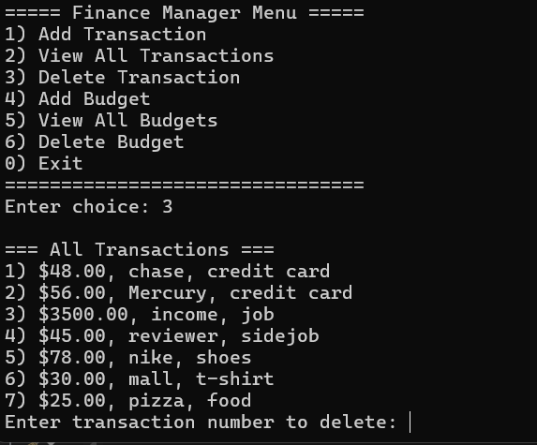
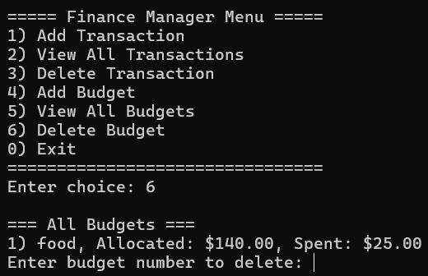
Demo

Slide 5
Future Work & Conclusion
Future Enhancements:
Date-range filters: let users view transactions/budgets within arbitrary time windows
Visualizations: spending charts (bar, pie, line) via a library (e.g. Matplotlib/SFML)
Import/Export Plugins: connect to bank APIs (CSV, OFX, Plaid) for automatic transaction pulls
Monthly Reset Scheduler: auto-zero budgets on 1st of month using std::chrono＋cron
GUI Front-end: a minimal Qt/SFML/ImGui interface for point-and-click ease
Key Takeaways:
Demonstrated modern C++ best practices (smart pointers, RAII, STL, templates)
Modular design: FinanceManager core + pluggable FileUtils I/O
Robust coverage: full Catch2 unit tests ensure correctness
Stable persistence: immediate CSV save on every change
Conclusion:
This Finance Manager app combines advanced C++ features with clean architecture and a full test suite—making it a solid portfolio piece and a foundation for further expansion.

